Slide 1

FOOSE:
Football Operator and Optical Soccer Engine
Sponsored by
Group 30:
Nathaniel Enos (EE)
Patrick Fenelon (CpE)
Skyler Goodell (CpE)
Nick Phillips (CpE)

Slide 2

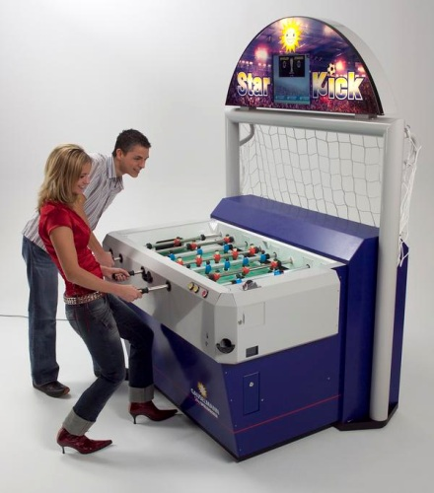
What is Foose?

Slide 3
Motivation
Diverse Engineering team
    Optical Image Processing
    Artificial Intelligence
    Software Engineering
    Linear Control Systems
    Robotics
SoarTech Sponsorship
    Showcase artificial intelligence in a “cool” domain
Notes:
Begin by introducing myself
Transition:
In the game’s century long history little has changed. We are not the first to attempt this automization. However we have some goals to differentiate our attempt from those before us.

Slide 4
Goals
Cost
  More affordable than competition
Size
  Minimize modification to the table
Entertaining/Competitive
  Entertaining to a novice user

Slide 5
Specifications
Component | Metric | Value
Camera | Framerate | 30 fps
Camera | Resolution | 640x480
Central Computer | Delay | 33 ms
Lateral motion | Speed | 1 m/s
Lateral Motion | Accuracy | 2.5cm
Kick | Speed | 2 m/s

Slide 6
FOOSE Layout
Table State Interpretation
AI
RCB
Motors
Linear Steppers
Radial Steppers

Slide 7
FOOSE Layout
Table State Interpretation
AI
RCB
Motors
Linear Steppers
Radial Steppers

Slide 8
FOOSE Layout
Table State Interpretation
AI
RCB
Motors
Linear Steppers
Radial Steppers

Slide 9
FOOSE Layout
Table State Interpretation
AI
RCB
Motors
Linear Steppers
Radial Steppers

Slide 10
FOOSE Layout
Table State Interpretation
AI
RCB
Motors
Linear Steppers
Radial Steppers

Slide 11
FOOSE Layout
Table State Interpretation
AI
RCB
Motors
Linear Steppers
Radial Steppers

Slide 12
Computer Vision Overview
Image Acquisition
Projection Normalization
Candidate Detection
Candidate Selection
Kalman Filter

Slide 13
Computer Vision Overview
Image Acquisition
Projection Normalization
Candidate Detection
Candidate Selection
Kalman Filter

Slide 14
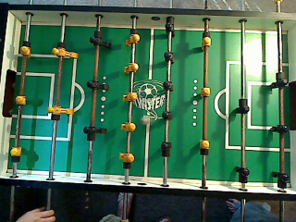
Color Camera

Slide 15
Color Camera
Distinguishing white ball from background

Slide 16
Color Camera
Distortion from motion blur

Slide 17
Color Camera
Distortion from motion blur
Gives direction but not in real time

Slide 18
Color Camera
Un-even lighting
Bright spots
Shadows

Slide 19
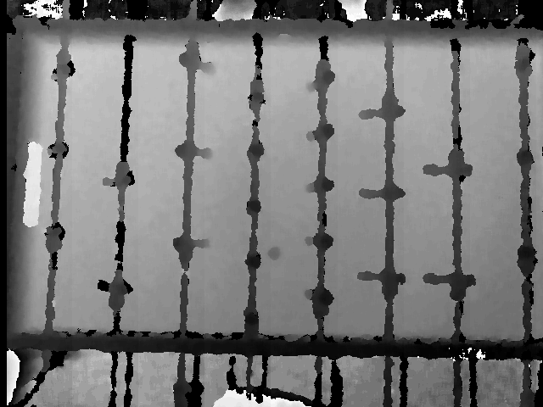
Depth Camera (Kinect)
Lighting irrelevant
No motion blur
Ball exists on unique depth level

Slide 20
Camera Selection
Camera | Cost | Resolution | Output Interpretation
Logitech QC 9000 | $0 Acquired (Retail $79.99) | Color - 1600 x 1200 | USB to Emgu CV C# / Open CV
Kinect (for Windows) | $0 Acquired (Retail $229.99) | Color - 1280 x 960 Depth- 640 x 480 | USB to Kinect SDK C#
TCM8230MD | $9.95 + PCB cost | Color - 640 x 480 | jpeg via I²C

Slide 21
Camera Selection
Camera | Cost | Resolution | Output Interpretation
Logitech QC 9000 | $0 Acquired (Retail $79.99) | Color - 1600 x 1200 | USB to Emgu CV C# / Open CV
Kinect (for Windows) | $0 Acquired (Retail $229.99) | Color - 1280 x 960 Depth- 640 x 480 | USB to Kinect SDK C#
TCM8230MD | $9.95 + PCB cost | Color - 640 x 480 | jpeg via I²C

Slide 22
Camera Selection
Camera | Cost | Resolution | Output Interpretation
Logitech QC 9000 | $0 Acquired (Retail $79.99) | Color - 1600 x 1200 | USB to Emgu CV C# / Open CV
Kinect (for Windows) | $0 Acquired (Retail $229.99) | Color - 1280 x 960 Depth- 640 x 480 | USB to Kinect SDK C#
TCM8230MD | $9.95 + PCB cost | Color - 640 x 480 | jpeg via I²C

Slide 23
Camera Selection
Camera | Cost | Resolution | Output Interpretation
Logitech QC 9000 | $0 Acquired (Retail $79.99) | Color - 1600 x 1200 | USB to Emgu CV C# / Open CV
Kinect (for Windows) | $0 Acquired (Retail $229.99) | Color - 1280 x 960 Depth- 640 x 480 | USB to Kinect SDK C#
TCM8230MD | $9.95 + PCB cost | Color - 640 x 480 | jpeg via I²C

Slide 24
Computer Vision Overview
Image Acquisition
Projection Normalization
Candidate Detection
Candidate Selection
Kalman Filter

Slide 25
Computer Vision Overview
Image Acquisition
Projection Normalization
Candidate Detection
Candidate Selection
Kalman Filter

Slide 26
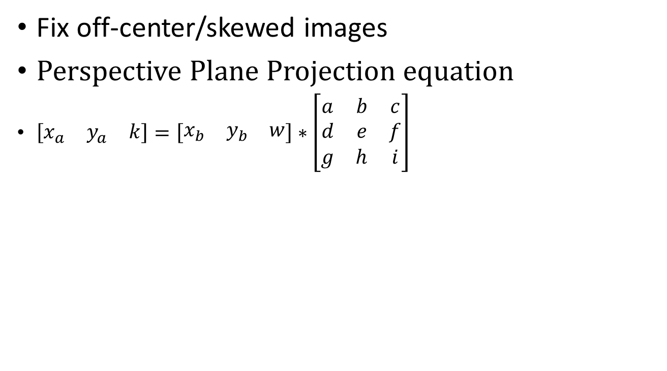
Projection Normalization

Slide 27
Projection Normalization

Slide 28
Projection Normalization
Equation needs
4 points to solve

Slide 29
Computer Vision Overview
Image Acquisition
Projection Normalization
Candidate Detection
Candidate Selection
Kalman Filter

Slide 30
Computer Vision Overview
Image Acquisition
Projection Normalization
Candidate Detection
Candidate Selection
Kalman Filter

Slide 31
Candidate Detection
Select all blobs at given depth level

Slide 32
Computer Vision Overview
Image Acquisition
Projection Normalization
Candidate Detection
Candidate Selection
Kalman Filter

Slide 33
Computer Vision Overview
Image Acquisition
Projection Normalization
Candidate Detection
Candidate Selection
Kalman Filter

Slide 34
Candidate Selection
Remove candidates represented by puppet feet by pattern recognition

Slide 35
Candidate Selection
Remove candidates represented by puppet feet by pattern recognition

Slide 36
Computer Vision Overview
Image Acquisition
Projection Normalization
Candidate Detection
Candidate Selection
Kalman Filter

Slide 37
Computer Vision Overview
Image Acquisition
Projection Normalization
Candidate Detection
Candidate Selection
Kalman Filter

Slide 38
Kalman Filter
Persistent physics model
  Removes noise
  Defines position
  Determines velocity

Slide 39
FOOSE Layout
Table State Interpretation
AI
RCB
Motors
Linear Steppers
Radial Steppers

Slide 40
FOOSE Layout
Table State Interpretation
AI
RCB
Motors
Linear Steppers
Radial Steppers

Slide 41
Central Computer
Purpose:
Runs computer vision (CV) and AI algorithms
Intermediary between visual input and
Rod Control Board (RCB)
Goals:
Run Kinect SDK
Run CV and AI algorithms with minimal delay

Slide 42
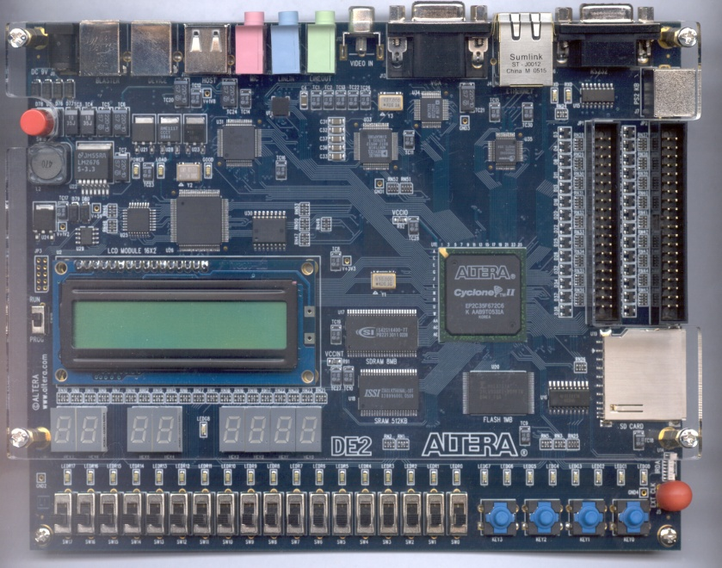
x86 vs. Embedded
FPGA approach
Would be capable of
performing tasks in time
Would have reasonable cost
(~$300 for Altera DE)
However:
Monetary cost is additional compared to computers which are already owned
Time cost is extreme, given our members’ familiarity with OpenCV and other libraries
Notes:
Wanted a software-intensive project

Slide 43
Central Computer
Target production machine:
Constraint for code development
X86-compatible architecture
Dual core at 2.3GHz with ~2GB RAM
Test machine:
16-core at 2.3GHz with ~32GB RAM
Was available to group
Notes:
Cheapest sufficient hardware

Slide 44
AI Overview
Responsible for:
  Taking ball position from CV system
  Calculating a move
  Outputting that move to the correct RCB
C#
  Ease of coding
  Compatibility with CV codebase
Which AI strategy?

Slide 45
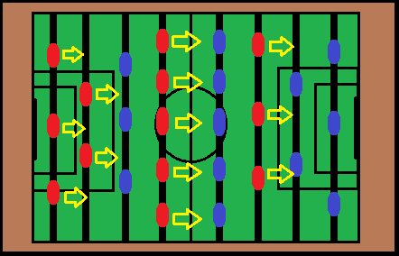
AI Strategies: Minimalist
The AI tries to hit/block the ball
Has some simple optimizations
  Raising and lowering puppets to increase block chance

Slide 46
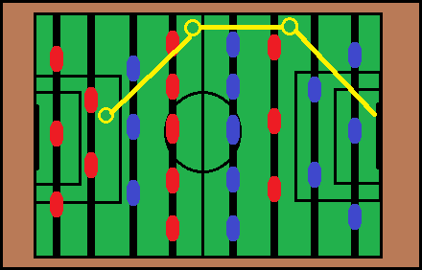
AI Strategies: Pathfinding
The AI tries to route a path to the goal
Includes ability to pass among computer-controlled puppets

Slide 47
AI Strategies
Minimalist
Pathfinding
Easier to conceptualize
Easier to code
Easier to implement
Used in production
Capable of far higher potential performance

Slide 48
AI Strategies
Minimalist
Pathfinding
Easier to conceptualize
Easier to code
Easier to implement
Used in production
Less challenging to human opponent
Capable of far higher potential performance

Slide 49
AI Strategies
Minimalist
Pathfinding
Easier to conceptualize
Easier to code
Easier to implement
Used in production
Less challenging to human opponent
Capable of far higher potential performance
Much more difficult to program
Only advantageous on very capable hardware

Slide 50
AI Strategies
At this point, we picked Minimalist
  “Challenging to a novice user”
May augment with elements of Pathfinding, if time permits

Slide 51
Challenges
Getting algorithms to work in real-time

Slide 52
FOOSE Layout
Table State Interpretation
AI
RCB
Motors
Linear Steppers
Radial Steppers

Slide 53
FOOSE Layout
Table State Interpretation
AI
RCB
Motors
Linear Steppers
Radial Steppers

Slide 54
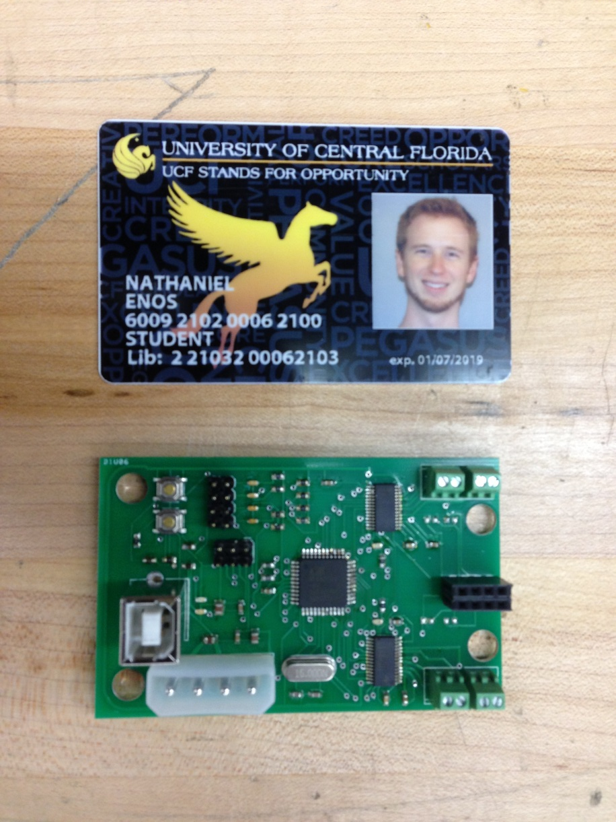
Rod Control Board (RCB)
Purpose
  Take in desired location and kick state of players from computer
  Take in sensor data
  Power and Control Actuators

Slide 56
Design Decisions
Microcontroller
Motor controller
Control Method

Slide 57
Microcontroller decision
Part | # of I/O | Speed | Arduino Friendly | USB on-board | Cost
MSP430 | 10 | 16 MHz | Sort of | No | $ 1.10
AVR ATmega32u4 | 26 | 16 MHz | Yes | Yes | $ 6.04
AVR Atmega2560 | 86 | 16 MHz | Yes | Yes | $ 17.97
PIC18F4550 | 35 | 48 MHz | No | Yes | $ 6.68

Slide 58
Microcontroller decision
Part | # of I/O | Speed | Arduino Friendly | USB on-board | Cost
MSP430 | 10 | 16 MHz | Sort of | No | $ 1.10
AVR ATmega32u4 | 26 | 16 MHz | Yes | Yes | $ 6.04
AVR Atmega2560 | 86 | 16 MHz | Yes | Yes | $ 17.97
PIC18F4550 | 35 | 48 MHz | No | Yes | $ 6.68

Slide 59
Microcontroller decision
Part | # of I/O | Speed | Arduino Friendly | USB on-board | Cost
MSP430 | 10 | 16 MHz | Sort of | No | $ 1.10
AVR ATmega32u4 | 26 | 16 MHz | Yes | Yes | $ 6.04
AVR Atmega2560 | 86 | 16 MHz | Yes | Yes | $ 17.97
PIC18F4550 | 35 | 48 MHz | No | Yes | $ 6.68

Slide 60
Microcontroller decision
Part | # of I/O | Speed | Arduino Friendly | USB on-board | Cost
MSP430 | 10 | 16 MHz | Sort of | No | $ 1.10
AVR ATmega32u4 | 26 | 16 MHz | Yes | Yes | $ 6.04
AVR Atmega2560 | 86 | 16 MHz | Yes | Yes | $ 17.97
PIC18F4550 | 35 | 48 MHz | No | Yes | $ 6.68

Slide 61
Microcontroller decision
Part | # of I/O | Speed | Arduino Friendly | USB on-board | Cost
MSP430 | 10 | 16 MHz | Sort of | No | $ 1.10
AVR ATmega32u4 | 26 | 16 MHz | Yes | Yes | $ 6.04
AVR Atmega2560 | 86 | 16 MHz | Yes | Yes | $ 17.97
PIC18F4550 | 35 | 48 MHz | No | Yes | $ 6.68

Slide 62
Motor controller decision
Part | Continuous Current Rating | Operating Voltage | On-board Microstepping | Control Complexity | Unit Cost (USD)
Stepper Driver DVR8825 | 1.8 A | 8.2-45 V | Yes | Low | $6.53
Stepper Driver A4975 | 1.5 A | 5-50 V | Yes | Low | $3.69
H-Bridge LMD18200 | 3.0 A | 12-55 V | No | High | $16.04
Dual H-Bridge L298N | 4.0 A | 2.5-46 V | No | High | $2.95

Slide 63
Motor controller decision
Part | Continuous Current Rating | Operating Voltage | On-board Microstepping | Control Complexity | Unit Cost (USD)
Stepper Driver DVR8825 | 1.8 A | 8.2-45 V | Yes | Low | $6.53
Stepper Driver A4975 | 1.5 A | 5-50 V | Yes | Low | $3.69
H-Bridge LMD18200 | 3.0 A | 12-55 V | No | High | $16.04
Dual H-Bridge L298N | 4.0 A | 2.5-46 V | No | High | $2.95

Slide 64
Motor controller decision
Part | Continuous Current Rating | Operating Voltage | On-board Microstepping | Control Complexity | Unit Cost (USD)
Stepper Driver DVR8825 | 1.8 A | 8.2-45 V | Yes | Low | $6.53
Stepper Driver A4975 | 1.5 A | 5-50 V | Yes | Low | $3.69
H-Bridge LMD18200 | 3.0 A | 12-55 V | No | High | $16.04
Dual H-Bridge L298N | 4.0 A | 2.5-46 V | No | High | $2.95

Slide 65
Motor controller decision
Part | Continuous Current Rating | Operating Voltage | On-board Microstepping | Control Complexity | Unit Cost (USD)
Stepper Driver DVR8825 | 1.8 A | 8.2-45 V | Yes | Low | $6.53
Stepper Driver A4975 | 1.5 A | 5-50 V | Yes | Low | $3.69
H-Bridge LMD18200 | 3.0 A | 12-55 V | No | High | $16.04
Dual H-Bridge L298N | 4.0 A | 2.5-46 V | No | High | $2.95

Slide 66
Motor controller decision
Part | Continuous Current Rating | Operating Voltage | On-board Microstepping | Control Complexity | Unit Cost (USD)
Stepper Driver DVR8825 | 1.8 A | 8.2-45 V | Yes | Low | $6.53
Stepper Driver A4975 | 1.5 A | 5-50 V | Yes | Low | $3.69
H-Bridge LMD18200 | 3.0 A | 12-55 V | No | High | $16.04
Dual H-Bridge L298N | 4.0 A | 2.5-46 V | No | High | $2.95

Slide 67
Motor controller decision
Part | Continuous Current Rating | Operating Voltage | On-board Microstepping | Control Complexity | Unit Cost (USD)
Stepper Driver DVR8825 | 1.8 A | 8.2-45 V | Yes | Low | $6.53
Stepper Driver A4975 | 1.5 A | 5-50 V | Yes | Low | $3.69
H-Bridge LMD18200 | 3.0 A | 12-55 V | No | High | $16.04
Dual H-Bridge L298N | 4.0 A | 2.5-46 V | No | High | $2.95

Slide 68
Motor controller decision
Part | Continuous Current Rating | Operating Voltage | On-board Microstepping | Control Complexity | Unit Cost (USD)
Stepper Driver DVR8825 | 1.8 A | 8.2-45 V | Yes | Low | $6.53
Stepper Driver A4975 | 1.5 A | 5-50 V | Yes | Low | $3.69
H-Bridge LMD18200 | 3.0 A | 12-55 V | No | High | $16.04
Dual H-Bridge L298N | 4.0 A | 2.5-46 V | No | High | $2.95

Slide 69
Stepper Motor Control
Control Method | Complexity | Incremental Cost | Drift Error
Closed-Loop | High | $ 119.80 | No
Open-Loop | Low | $ 16.00 | Yes

Slide 70
Stepper Motor Control
Control Method | Complexity | Incremental Cost | Drift Error
Closed-Loop | High | $ 119.80 | No
Open-Loop | Low | $ 16.00 | Yes

Slide 71
Stepper Motor Control
Control Method | Complexity | Incremental Cost | Drift Error
Closed-Loop | High | $ 119.80 | No
Open-Loop | Low | $ 16.00 | Yes

Slide 72
Power
Using standard PC power supply for the PC and PCB boards
Using 12 VDC, 5 VDC and 3.3 VDC

Slide 73
challenges
DVR8825 showing poor current performance
Accuracy will degrade if calibration is not frequent enough

Slide 74
FOOSE Layout
Table State Interpretation
AI
RCB
Motors
Linear Steppers
Radial Steppers

Slide 75
FOOSE Layout
Table State Interpretation
AI
RCB
Motors
Linear Steppers
Radial Steppers

Slide 76
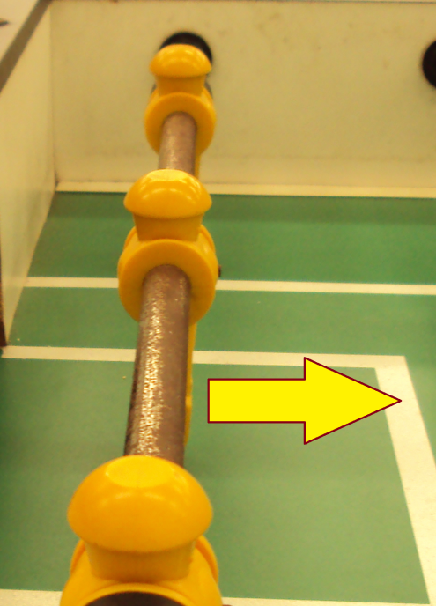
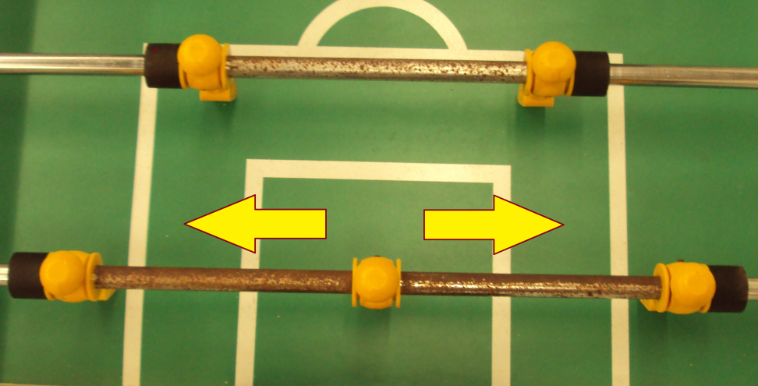
Mechanical/Robotic Design
Two primary actuations:
  Linear Motion
  Rotational Motion
Notes:
Discuss benefits of fooseball domain.
*transition: we will need some form of actuation, but we need a baseline to choose from. (stress that what I will show you is for estimation purposes and not a hard requirement. It helped us make decisions)

Slide 77
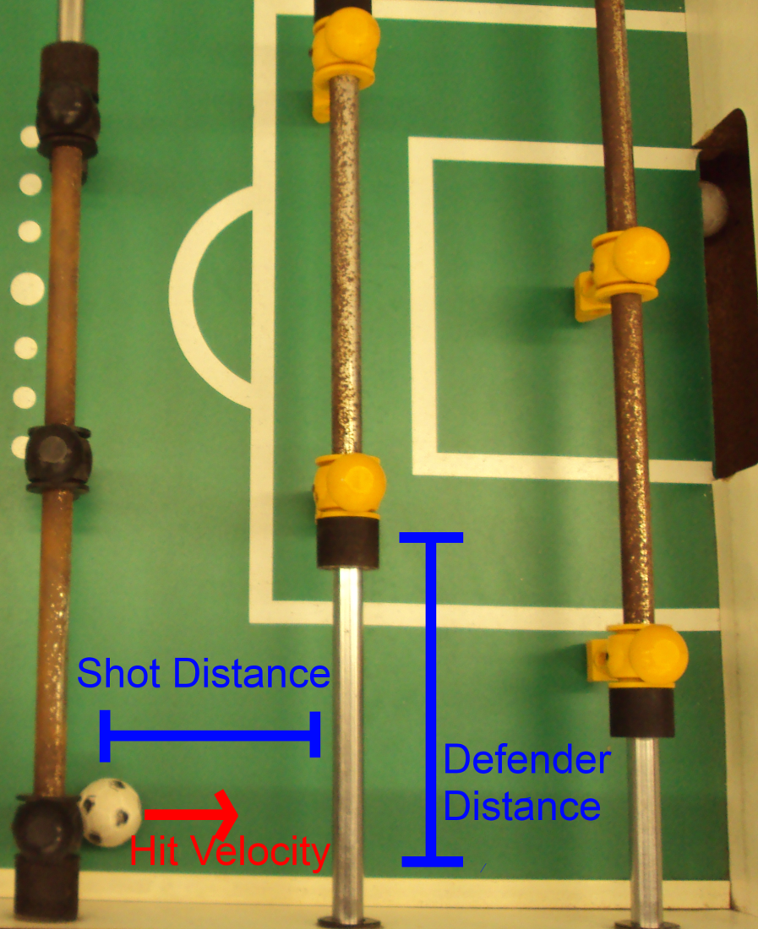
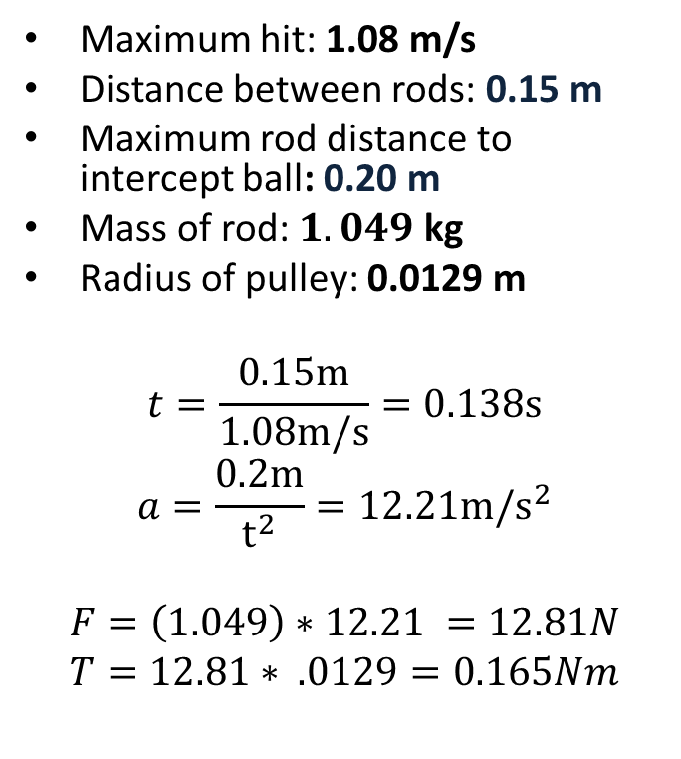
Linear Motion Specifications
CONCLUSION: 0.165Nm Torque at 1247 rpm

Slide 78
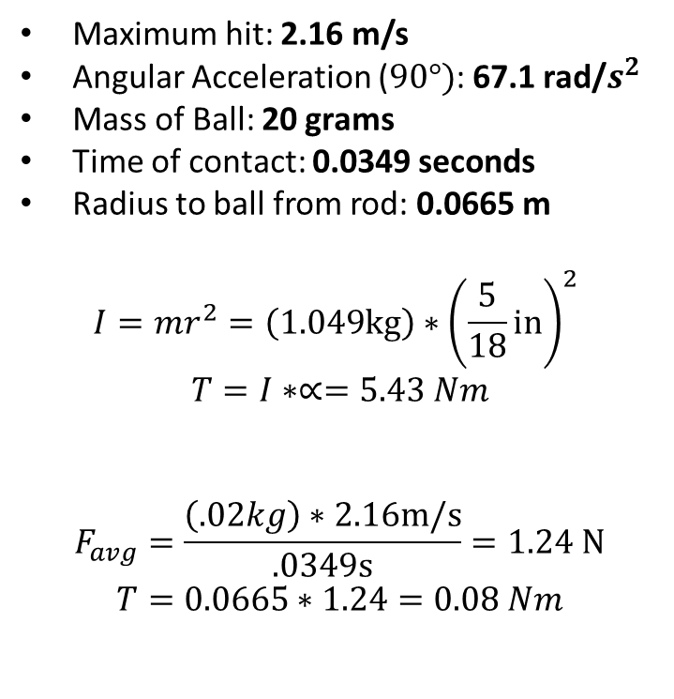
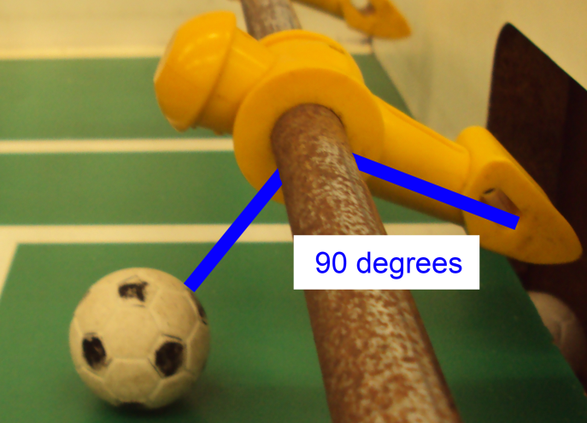
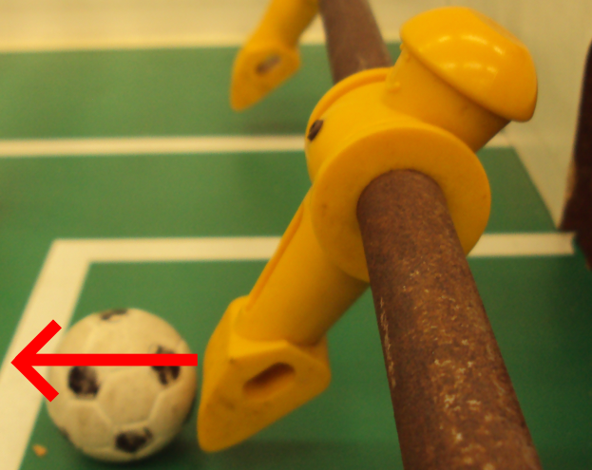
Rotational Motion Specifications
CONCLUSION: 5.51 Nm Torque at 310 rpm

Slide 79
Motor Options
Name | Cost | Voltage Rating | Current Rating | Watts (max) | Torque | RPM
Johnson Electric HC615-64823 | $5.95 | 6-24 VDC | 0.22A | 5.3 W | 0.011 Nm | 4700
CIM AM802-001A | $28.00 | 12 VDC | 68 A | 337 W | 2.42 Nm | 5310
BaneBot RS775 | $12.75 | 6-18 VDC | 5.7 A | 63.4 W | 0.083Nm | 7300
Sparkfun ROB-09238 | $14.95 | 12 V | 0.33 A | 4 W | 0.016 Nm | 180
NEMA 6627T31 | $86.67 | 12–40 V | 0.45 A | 18 W | 0.057 Nm | 3000
Japan Servo KH56JM2-901 | $91.84 | 12-24 V | 1.0 A | 12 W | 0.3 Nm | 1500
LINEAR: 0.165Nm Torque at 1247 rpm ROTATIONAL: 5.51 Nm Torque at 310 rpm
Notes:
http://www.engineeringtoolbox.com/electrical-motors-hp-torque-rpm-d_1503.html
Notes:
http://www.skycraftsurplus.com/dchobbymotor6-24vdc.aspx
http://www.andymark.com/CIM-motor-FIRST-p/am-0255.htm
http://banebots.com/pc/MOTOR-BRUSH/M5-RS775-12
https://www.sparkfun.com/products/9238
http://www.mcmaster.com/#stepper-motors/=lj77o5
http://www.nidec-servo.com/en/digital/c_ste/index.html
Is the one we found on ebay: KH56JM2-901B004

Slide 80
Motor Options
Name | Cost | Voltage Rating | Current Rating | Watts (max) | Torque | RPM
Johnson Electric HC615-64823 | $5.95 | 6-24 VDC | 0.22A | 5.3 W | 0.011 Nm | 4700
CIM AM802-001A | $28.00 | 12 VDC | 68 A | 337 W | 2.42 Nm | 5310
BaneBot RS775 | $12.75 | 6-18 VDC | 5.7 A | 63.4 W | 0.083Nm | 7300
Sparkfun ROB-09238 | $14.95 | 12 V | 0.33 A | 4 W | 0.016 Nm | 180
NEMA 6627T31 | $86.67 | 12–40 V | 0.45 A | 18 W | 0.057 Nm | 3000
Japan Servo KH56JM2-901 | $91.84 | 12-24 V | 1.0 A | 12 W | 0.3 Nm | 1500
LINEAR: 0.165Nm Torque at 1247 rpm ROTATIONAL: 5.51 Nm Torque at 310 rpm
Notes:
http://www.engineeringtoolbox.com/electrical-motors-hp-torque-rpm-d_1503.html
Notes:
http://www.skycraftsurplus.com/dchobbymotor6-24vdc.aspx
http://www.andymark.com/CIM-motor-FIRST-p/am-0255.htm
http://banebots.com/pc/MOTOR-BRUSH/M5-RS775-12
https://www.sparkfun.com/products/9238
http://www.mcmaster.com/#stepper-motors/=lj77o5
http://www.nidec-servo.com/en/digital/c_ste/index.html
Is the one we found on ebay: KH56JM2-901B004

Slide 81
Motor Options
Name | Cost | Voltage Rating | Current Rating | Watts (max) | Torque | RPM
Johnson Electric HC615-64823 | $5.95 | 6-24 VDC | 0.22A | 5.3 W | 0.011 Nm | 4700
CIM AM802-001A | $28.00 | 12 VDC | 68 A | 337 W | 2.42 Nm | 5310
BaneBot RS775 | $12.75 | 6-18 VDC | 5.7 A | 63.4 W | 0.083Nm | 7300
Sparkfun ROB-09238 | $14.95 | 12 V | 0.33 A | 4 W | 0.016 Nm | 180
NEMA 6627T31 | $86.67 | 12–40 V | 0.45 A | 18 W | 0.057 Nm | 3000
Japan Servo KH56JM2-901 | $91.84 | 12-24 V | 1.0 A | 12 W | 0.3 Nm | 1500
LINEAR: 0.165Nm Torque at 1247 rpm ROTATIONAL: 5.51 Nm Torque at 310 rpm
Notes:
http://www.engineeringtoolbox.com/electrical-motors-hp-torque-rpm-d_1503.html
Notes:
http://www.skycraftsurplus.com/dchobbymotor6-24vdc.aspx
http://www.andymark.com/CIM-motor-FIRST-p/am-0255.htm
http://banebots.com/pc/MOTOR-BRUSH/M5-RS775-12
https://www.sparkfun.com/products/9238
http://www.mcmaster.com/#stepper-motors/=lj77o5
http://www.nidec-servo.com/en/digital/c_ste/index.html
Is the one we found on ebay: KH56JM2-901B004

Slide 82
Motor Options
Name | Cost | Voltage Rating | Current Rating | Watts (max) | Torque | RPM
Johnson Electric HC615-64823 | $5.95 | 6-24 VDC | 0.22A | 5.3 W | 0.011 Nm | 4700
CIM AM802-001A | $28.00 | 12 VDC | 68 A | 337 W | 2.42 Nm | 5310
BaneBot RS775 | $12.75 | 6-18 VDC | 5.7 A | 63.4 W | 0.083Nm | 7300
Sparkfun ROB-09238 | $14.95 | 12 V | 0.33 A | 4 W | 0.016 Nm | 180
NEMA 6627T31 | $86.67 | 12–40 V | 0.45 A | 18 W | 0.057 Nm | 3000
Japan Servo KH56JM2-901 | $91.84 | 12-24 V | 1.0 A | 12 W | 0.3 Nm | 1500
LINEAR: 0.165Nm Torque at 1247 rpm ROTATIONAL: 5.51 Nm Torque at 310 rpm
Notes:
http://www.engineeringtoolbox.com/electrical-motors-hp-torque-rpm-d_1503.html
Notes:
http://www.skycraftsurplus.com/dchobbymotor6-24vdc.aspx
http://www.andymark.com/CIM-motor-FIRST-p/am-0255.htm
http://banebots.com/pc/MOTOR-BRUSH/M5-RS775-12
https://www.sparkfun.com/products/9238
http://www.mcmaster.com/#stepper-motors/=lj77o5
http://www.nidec-servo.com/en/digital/c_ste/index.html
Is the one we found on ebay: KH56JM2-901B004

Slide 83
Motor Options
Name | Cost | Voltage Rating | Current Rating | Watts (max) | Torque | RPM
Johnson Electric HC615-64823 | $5.95 | 6-24 VDC | 0.22A | 5.3 W | 0.011 Nm | 4700
CIM AM802-001A | $28.00 | 12 VDC | 68 A | 337 W | 2.42 Nm | 5310
BaneBot RS775 | $12.75 | 6-18 VDC | 5.7 A | 63.4 W | 0.083Nm | 7300
Sparkfun ROB-09238 | $14.95 | 12 V | 0.33 A | 4 W | 0.016 Nm | 180
NEMA 6627T31 | $86.67 | 12–40 V | 0.45 A | 18 W | 0.057 Nm | 3000
Japan Servo KH56JM2-901 | $ 8.33 | 12-24 V | 1.0 A | 12 W | 0.3 Nm | 1500
LINEAR: 0.165Nm Torque at 1247 rpm ROTATIONAL: 5.51 Nm Torque at 310 rpm
Notes:
http://www.engineeringtoolbox.com/electrical-motors-hp-torque-rpm-d_1503.html
Notes:
http://www.skycraftsurplus.com/dchobbymotor6-24vdc.aspx
http://www.andymark.com/CIM-motor-FIRST-p/am-0255.htm
http://banebots.com/pc/MOTOR-BRUSH/M5-RS775-12
https://www.sparkfun.com/products/9238
http://www.mcmaster.com/#stepper-motors/=lj77o5
http://www.nidec-servo.com/en/digital/c_ste/index.html
Is the one we found on ebay: KH56JM2-901B004

Slide 84
Motor Options
Name | Cost | Voltage Rating | Current Rating | Watts (max) | Torque | RPM
Johnson Electric HC615-64823 | $5.95 | 6-24 VDC | 0.22A | 5.3 W | 0.011 Nm | 4700
CIM AM802-001A | $28.00 | 12 VDC | 68 A | 337 W | 2.42 Nm | 5310
BaneBot RS775 | $12.75 | 6-18 VDC | 5.7 A | 63.4 W | 0.083Nm | 7300
Sparkfun ROB-09238 | $14.95 | 12 V | 0.33 A | 4 W | 0.016 Nm | 180
NEMA 6627T31 | $86.67 | 12–40 V | 0.45 A | 18 W | 0.057 Nm | 3000
Japan Servo KH56JM2-901 | $ 8.33 | 12-24 V | 1.0 A | 12 W | 0.3 Nm | 1500
LINEAR: 0.165Nm Torque at 1247 rpm ROTATIONAL: 5.51 Nm Torque at 310 rpm
Notes:
http://www.engineeringtoolbox.com/electrical-motors-hp-torque-rpm-d_1503.html
Notes:
http://www.skycraftsurplus.com/dchobbymotor6-24vdc.aspx
http://www.andymark.com/CIM-motor-FIRST-p/am-0255.htm
http://banebots.com/pc/MOTOR-BRUSH/M5-RS775-12
https://www.sparkfun.com/products/9238
http://www.mcmaster.com/#stepper-motors/=lj77o5
http://www.nidec-servo.com/en/digital/c_ste/index.html
Is the one we found on ebay: KH56JM2-901B004

Slide 85
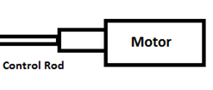
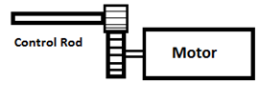
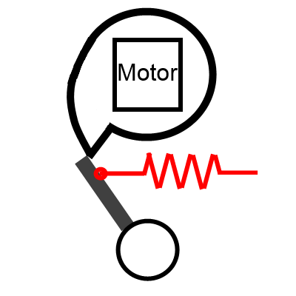
Rotational Motion
Name | Cost
1:1 Mounted Motor | ~$2
Geared Mounted Motor | $15
CAM Kicker | $5
RECALL: 5.51 Nm Torque at 310 rpm
Notes:
Maybe highlight our decision
Update our values from mcmaster

Slide 86
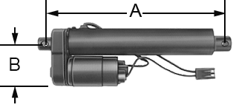
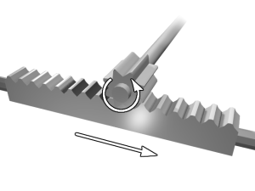
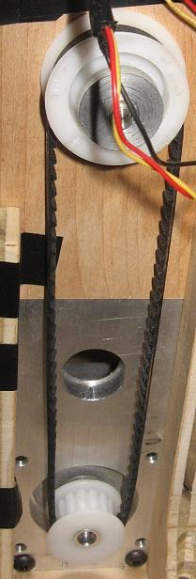
Linear Motion
Name | Cost
Industrial Linear Actuators | $399 - up
Rack and Pinion | $25
Chain or Belt Driven Pulley System | $15
RECALL: 0.165Nm Torque at 1247 rpm
Notes:
Maybe highlight our decision
Update values from mcmaster

Slide 87
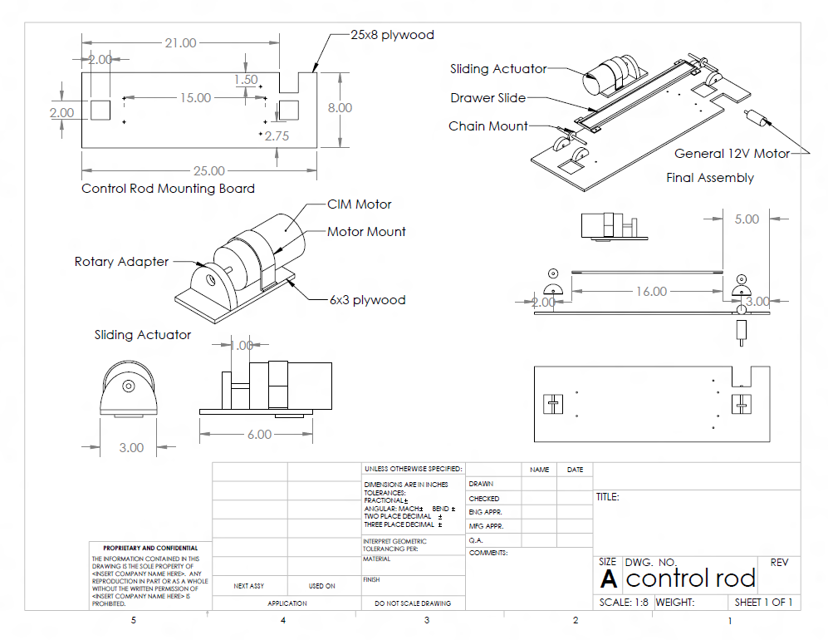
Final Design
Notes:
MAKE THE CAD

Slide 88
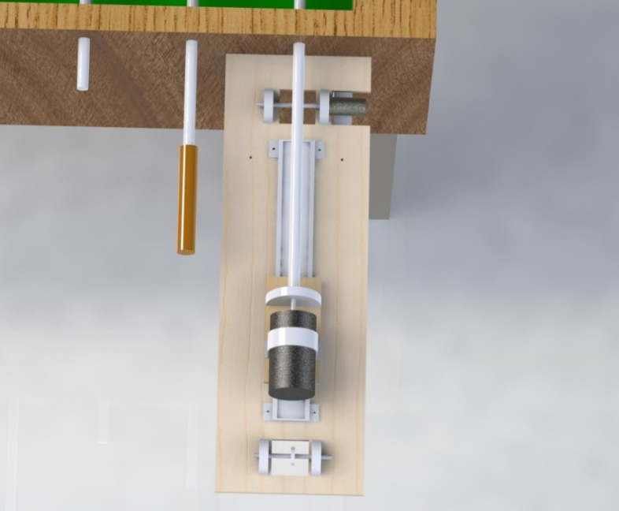
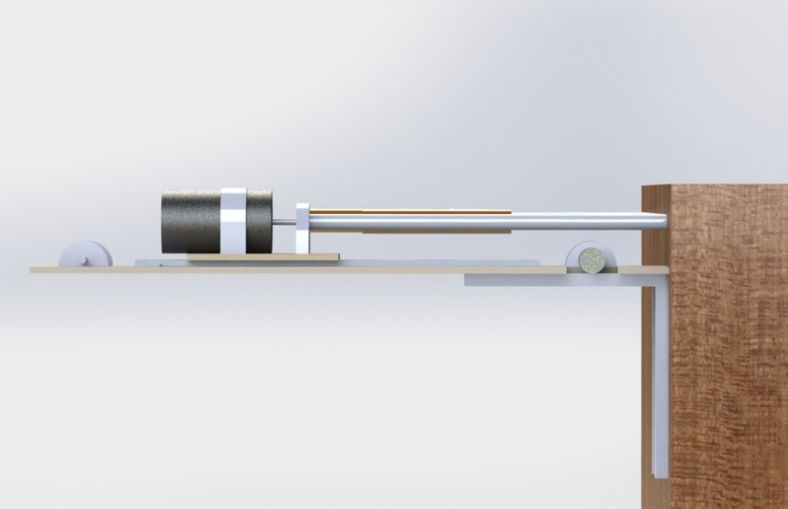
Final Design
Notes:
MAKE THE CAD

Slide 89
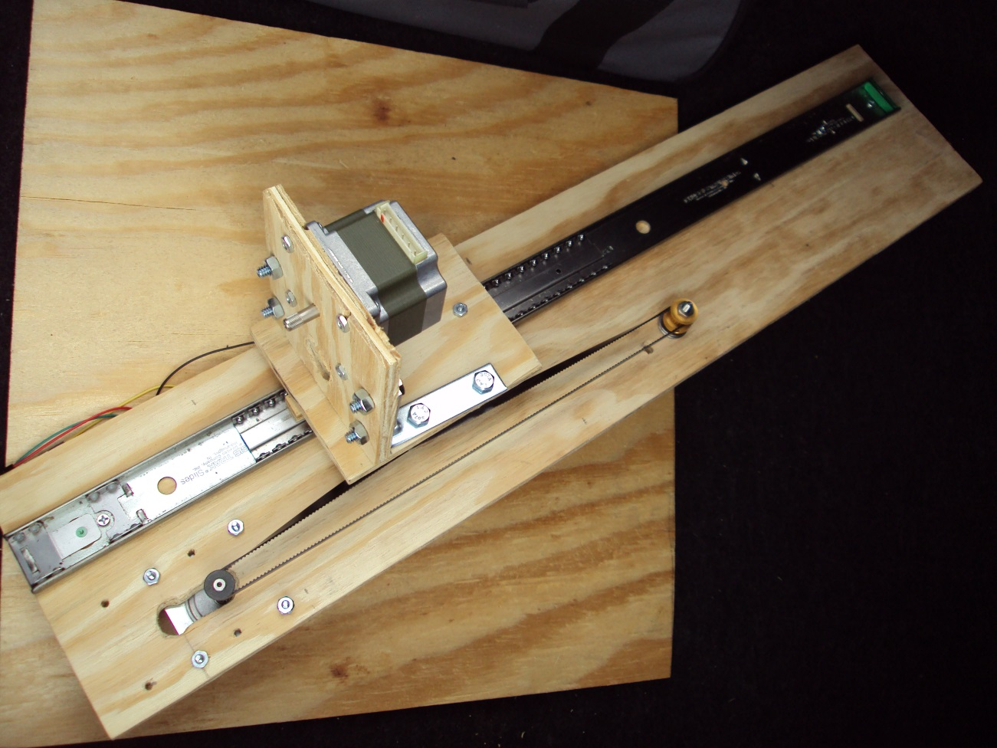
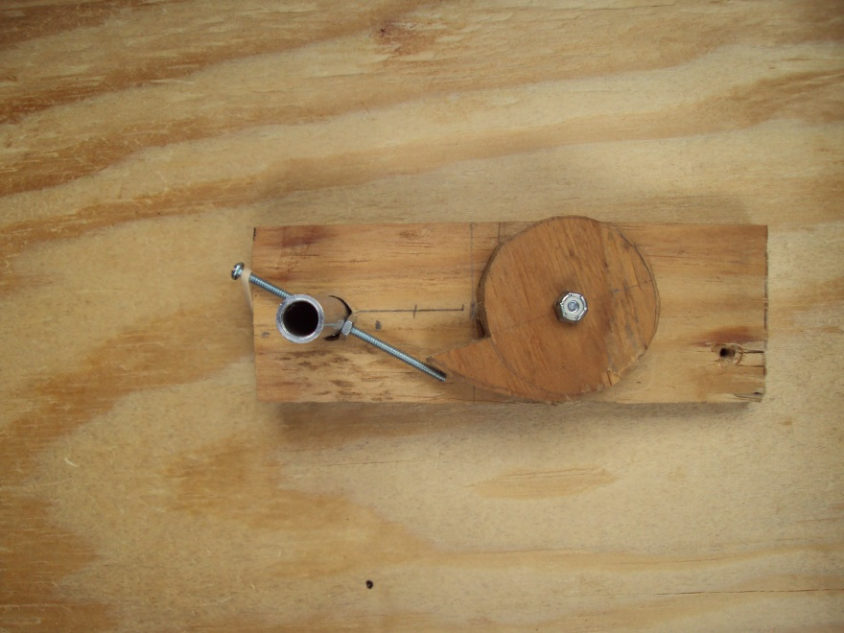
Final Design
Notes:
MAKE THE CAD

Slide 90
Challenges
Lower durability of plywood
The speed of actuators are not going to reach human level speed or control

Slide 91
Foose Administration

Slide 92
Distribution of Work
 | CV | Computer | AI | RCB | Mechanics
Nate |  |  |  | X | X
Patrick | X |  |  | X
Skyler |  |  | X |  | X
Nick |  | X | X

Slide 93
Item Name | Supplier | Price per unit | Number | Total |  | Item Name | Supplier | Price per unit | Number | Total
Foosball Table | Private Seller | $40.00 | 1 | $40.00 |  | L298N Heatsinks | SparkFun | $3.95 | 8 | $31.60
DRV8825 Breakout | BatchPCB | $3.34 | 2 | $6.68 |  | Masking Tape | Home Depot | $2.27 | 1 | $2.27
RCB v1 Printing | BatchPCB | $15.99 | 1 | $15.99 |  | Twine | Home Depot | $2.97 | 1 | $2.97
RCB v2 Printing | BatchPCB | $25.11 | 2 | $50.22 |  | Caution Tape | Home Depot | $5.49 | 1 | $5.49
10uF Capacitors | DigiKey | $0.15 | 100 | $15.05 |  | ATMega32U4 Microcontroller | SparkFun | $6.95 | 5 | $34.75
10mOhm Resistors | DigiKey | $0.02 | 200 | $4.59 |  | Molex Connectors | SparkFun | $0.86 | 10 | $8.60
1kOhm Resistors | DigiKey | $0.02 | 200 | $4.59 |  | USB Female Type B Connector | SparkFun | $0.86 | 10 | $8.60
DRV8842PWP Stepper Driver | DigiKey | $5.87 | 12 | $70.48 |  | SMD Push-button switch | SparkFun | $0.86 | 10 | $8.60
120 Ohm Ferrite Chip | DigiKey | $0.06 | 10 | $0.61 |  | SMD LEDs- Green | SparkFun | $4.95 | 2 | $9.90
1mOhm Resistors | DigiKey | $0.02 | 200 | $4.59 |  | SMD LEDs- Red | SparkFun | $5.95 | 1 | $5.95
470uF Capacitors | DigiKey | $0.55 | 50 | $27.50 |  | 16MHz Oscillator Crystal | SparkFun | $0.95 | 5 | $4.75
750 Ohm Resistors | DigiKey | $0.02 | 200 | $4.59 |  | SMD LEDs- Blue | SparkFun | $14.95 | 1 | $14.95
100 Ohm Ferrite Chip | DigiKey | $0.07 | 10 | $0.73 |  | KH56JM2B004 Stepper Motors | Ebay | $6.94 | 18 | $125.00
30 Ohm Ferrite Chip | DigiKey | $0.06 | 10 | $0.61 |  | 20-teeth 1/4" Pulley | McMaster-Carr | $10.77 | 1 | $10.77
470 Ohm Ferrite Chip | DigiKey | $0.07 | 10 | $0.73 |  | 14-teeth 1/4" Pulley | McMaster-Carr | $7.51 | 1 | $7.51
60 Ohm Ferrite Chip | DigiKey | $0.06 | 10 | $0.61 |  | 320MXL Timing Belt | McMaster-Carr | $5.84 | 1 | $5.84
180 Ohm Ferrite Chip | DigiKey | $0.07 | 10 | $0.73 |  | 270MXL Timing Belt | McMaster-Carr | $9.82 | 1 | $9.82
L298N H-Bridges | SparkFun | $2.66 | 12 | $31.92 |  | 1-1/4" Shoulder Screws | McMaster-Carr | $4.17 | 1 | $4.17
1" Shoulder Screws | McMaster-Carr | $3.67 | 1 | $3.67
3/8" Titanium Hex Nuts | McMaster-Carr | $2.74 | 2 | $5.48 |  |  |  | Subtotal | $603.90
1/4" Washers | McMaster-Carr | $5.88 | 1 | $5.88 |  | Shipping and Handling |  |  |  | $109.46
1/4" Hex Bolts | McMaster-Carr | $4.43 | 1 | $4.43 |  | Tax |  |  |  | $9.31
1/4" Hex Nuts | McMaster-Carr | $2.68 | 1 | $2.68 |  |  |  | Total | $722.67

Slide 94
Financing
Major sponsor: SoarTech
  $500 is about half of budget
Possible sale of completed board
Otherwise, self-funded

Slide 95
Overall Progress

